Slide 1
Radiowave propagation
Notes:
1

Slide 2
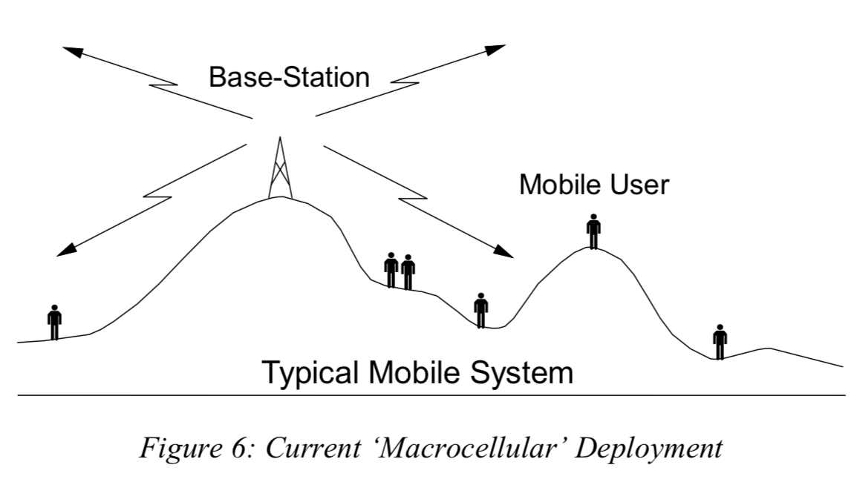
Radiowave Propagation (1)
Mobile services are mainly based on elevated basestations that communicate with a number of moving mobiles (point-to-multipoint)
To support these mobile services:
Outdoors: we consider effects such as:
Irregular terrain
User motion
Build-up areas
Indoors: we consider factors such as:
Transmission through walls, floors
and ceilings

Slide 3
Radiowave Propagation (2)
Design of mobile communication systems is based on three propagation terms:
1. Free Space Path Loss (Attenuation)
2. Multipath and Shadowing
3. Time Delay Spread

Slide 4
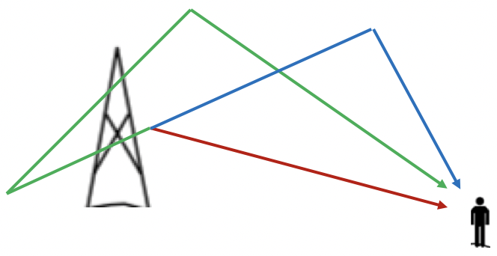
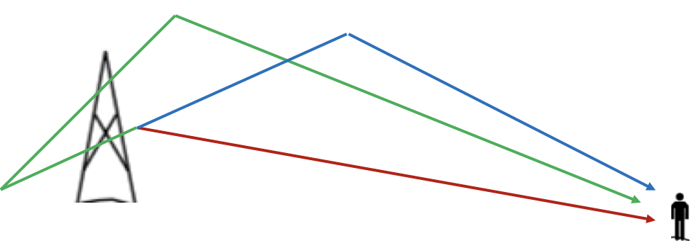
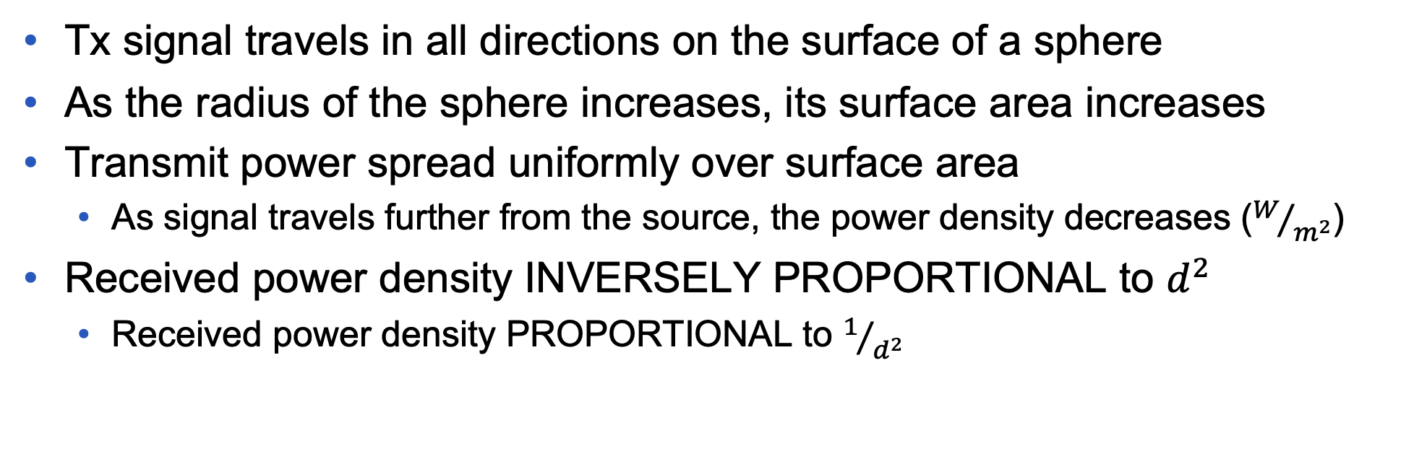
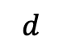
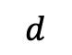
Received Power Density
Tx signal travels in all directions on the surface of a sphere
As the radius of the sphere increases, its surface area increases
Transmit power spread uniformly over surface area
As signal travels further from the source, the power density decreases ($W/{m^{2}}$)
Received power density INVERSELY PROPORTIONAL to $d^{2}$
Received power density PROPORTIONAL to $1/{d^{2}}$
Power density reduces
$$d$$
$$d$$

Slide 5
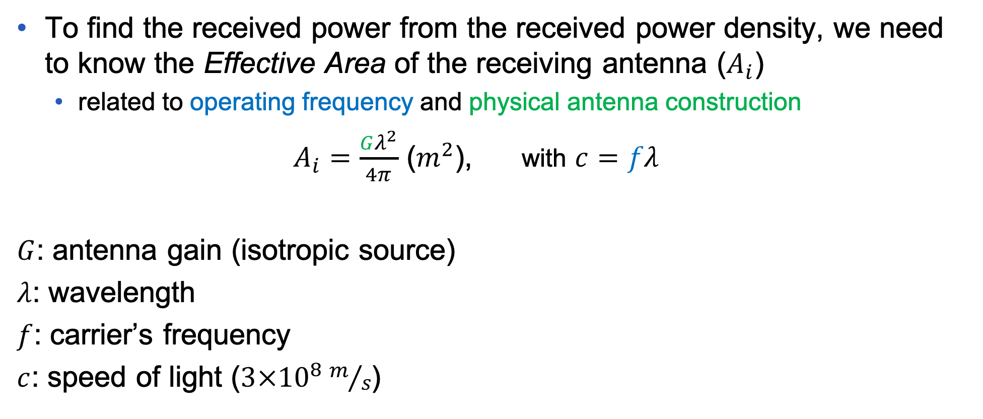
Effective Area of Antenna
To find the received power from the received power density, we need to know the Effective Area of the receiving antenna ($A_{i}$)
related to operating frequency and physical antenna construction
$A_{i}=\frac{Gλ^{2}}{4π}$ ($m^{2}$), with $c=fλ$
$G$: antenna gain (isotropic source)
$λ$: wavelength
$f$: carrier’s frequency
$c$: speed of light ($3×{10}^{8}m/s$)

Slide 6
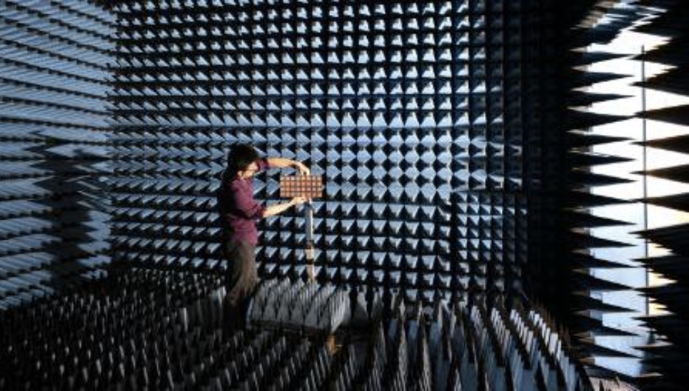
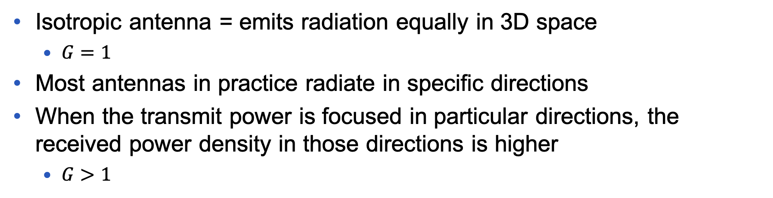
Antenna Gain
Isotropic antenna = emits radiation equally in 3D space
$G=1$
Most antennas in practice radiate in specific directions
When the transmit power is focused in particular directions, the received power density in those directions is higher
$G>1$
The antenna gain is provided by manufacturer or measured in an anechoic chamber
absorbs and prevents the reflection of both sound and
electromagnetic waves
https://www.youtube.com/watch?v=qWQ3S1tDVSY

Slide 7
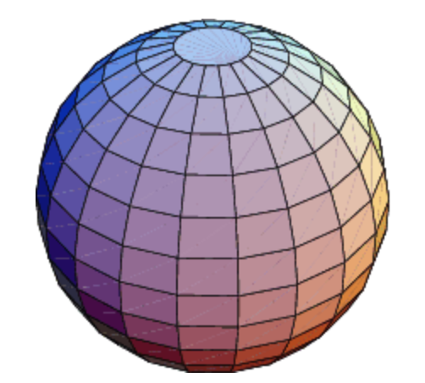
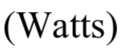
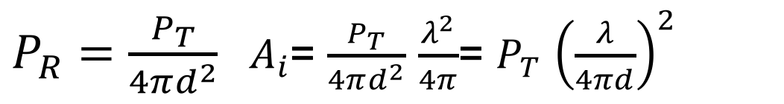
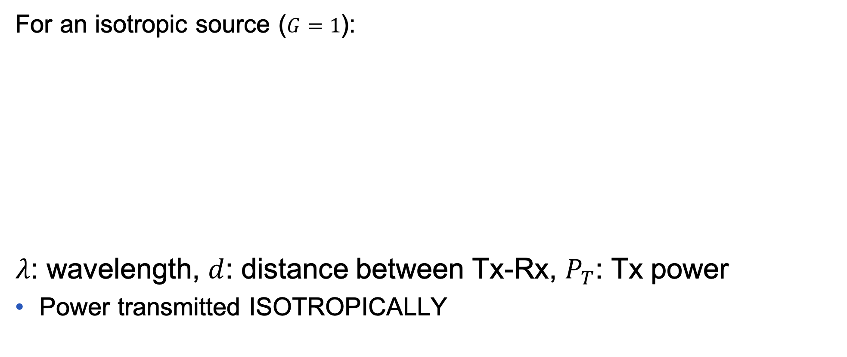
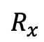
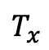
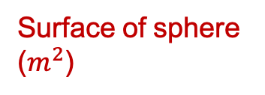
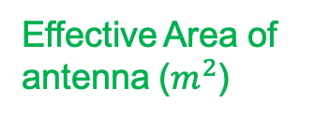
Free Space Equation (Isotropic Source)
Rx power density (W)
For an isotropic source ($G=1$):
$λ$: wavelength, $d$: distance between Tx-Rx, $P_{T}$: Tx power
Power transmitted ISOTROPICALLY
Effective Area of antenna ($m^{2}$)
$P_{R}=\frac{P_{T}}{4πd^{2}}$ ${ A}_{i}$= $\frac{P_{T}}{4πd^{2}}$ $\frac{λ^{2}}{4π}$= $P_{T}$ ${\left(\frac{λ}{4πd}\right)}^{2}$
$$T_{x}$$
$$d$$
$$R_{x}$$
Surface of sphere ($m^{2}$)

Slide 8
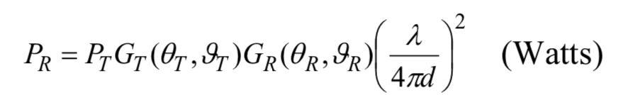
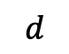
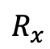
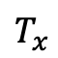
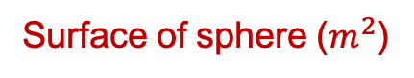
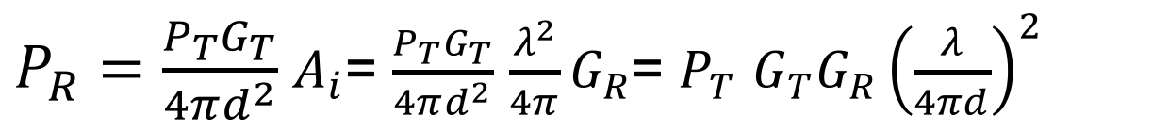
Free Space Equation
Taking into account Real antenna gain patterns (Rx,Tx):
antenna gain as a function of azimuth , and , elevation angle
EIRP (Equivalent Isotropically Radiated Power)
$P_{R}=\frac{P_{T}G_{T}}{4πd^{2}}$ $A_{i}$= $\frac{P_{T}G_{T}}{4πd^{2}}$ $\frac{λ^{2}}{4π}G_{R}$= $P_{T}$ $G_{T}G_{R}{\left(\frac{λ}{4πd}\right)}^{2}$
$$T_{x}$$
$$d$$
$$R_{x}$$
Surface of sphere ($m^{2}$)

Slide 9
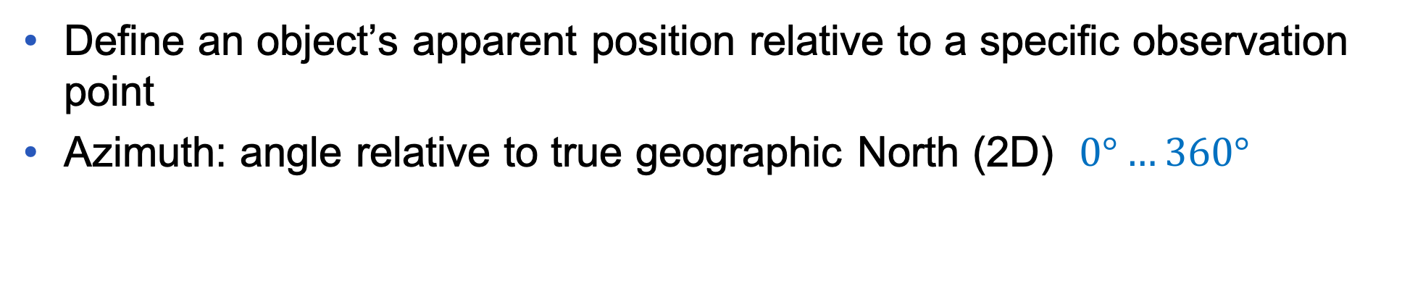


Azimuth-Elevation angles
Define an object’s apparent position relative to a specific observation point
Azimuth: angle relative to true geographic North (2D) $0°…360°$
Elevation: angle between the object and the observer’s local horizon (3D) $−90°…0°…90°$
elevation
North
azimuth
elevation
West
90$°$
East
elevation
azimuth
180$°$
Observed plane
South

Slide 10
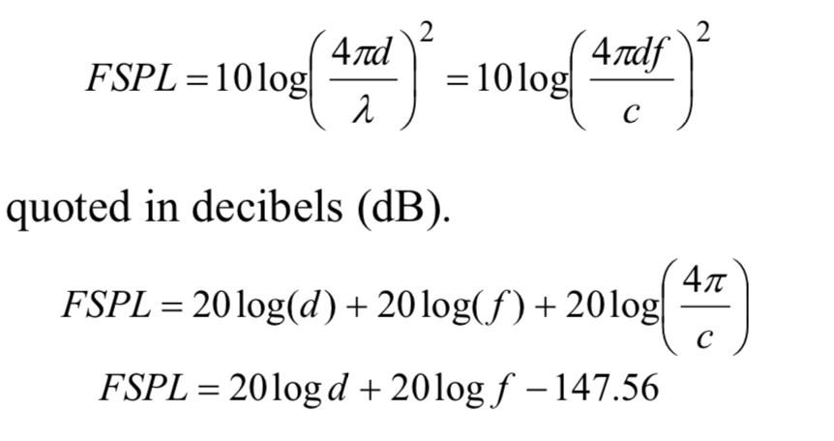
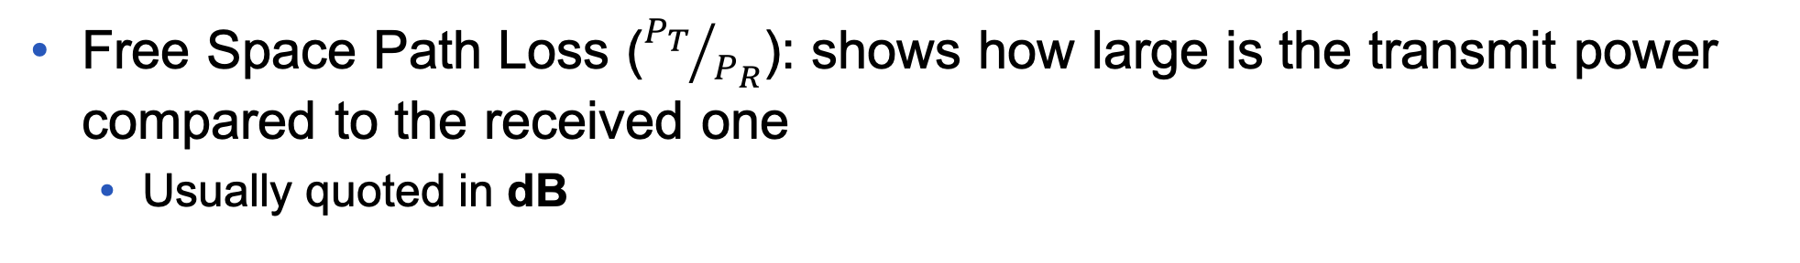
Free Space Path Loss
Free Space Path Loss (${P_{T}}/{P_{R}}$): shows how large is the transmit power compared to the received one
Usually quoted in dB
Free Space Path Loss (isotropic antennas: $G=1$):

Slide 11
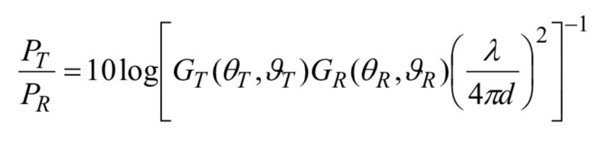

Propagation Path Loss
Propagation Path Loss (${P_{T}}/{P_{R}}$): shows how large is the transmit power compared to the received one
Usually quoted in dB
Propagation Path Loss (non isotropic source):
$$PL=20\log\left(d\right)+20\log\left(f\right)+20\log\left(\frac{4π}{c}\right)−10logG_{R}−10logG_{T}$$

Slide 12
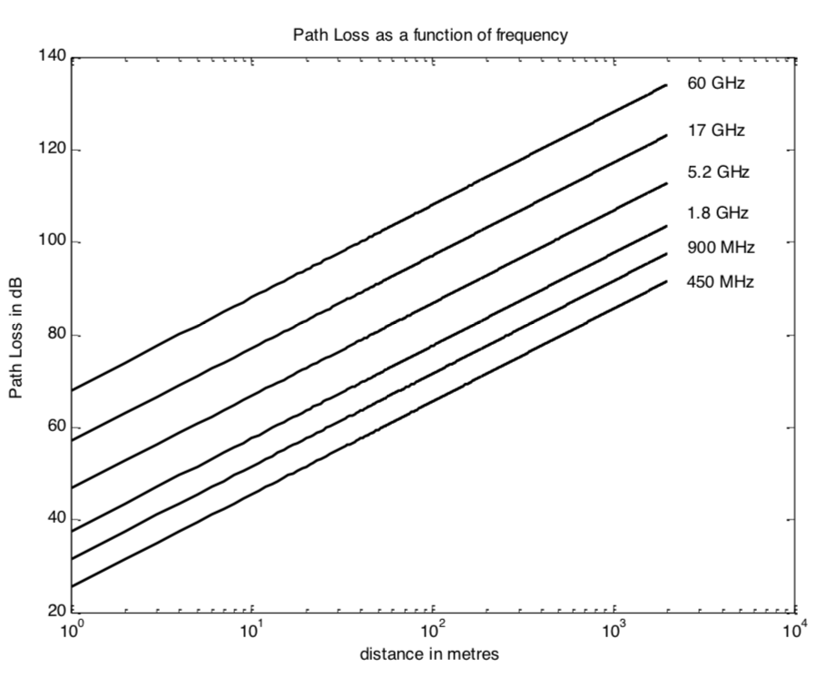
Path Loss vs. Frequency and Distance
Notes:
All equations good for systems with dominant strong Line of Sight (satellite and microwave p2p comms…where multipaths with mobile radio apps not that good

Slide 13

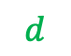
Example (1)
What is the free space path loss that a satellite transmitting at 8 GHz over a 36,000 km path will experience?
$$d$$
$$f$$
$FSPL=10log{\left(\frac{4π×36×{10}^{6}×8×{10}^{9}}{3×{10}^{8}}\right)}^{2}$= $10log\left(1.45×{10}^{20}\right)=201.61dB$
Notes:
All equations good for systems with dominant strong Line of Sight (satellite and microwave p2p comms…where multipaths with mobile radio apps not that good

Slide 14
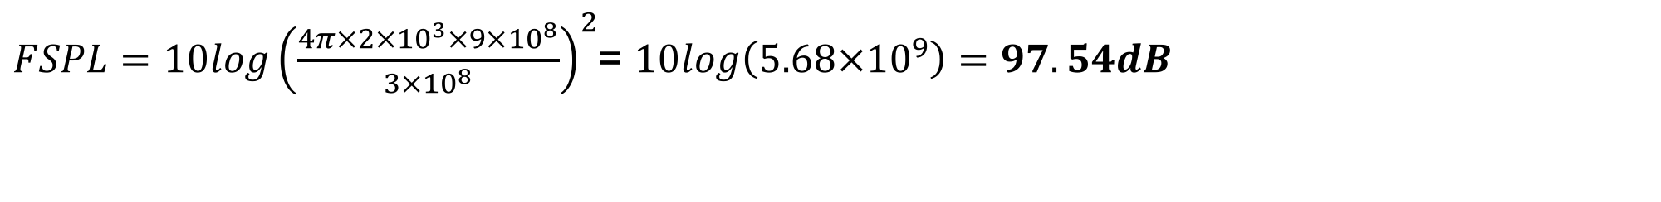

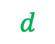
Example (2)
What is the free space path loss that a cellular radio system operating at 900 MHz will experience for a 2 km path?
$$d$$
$$f$$
$FSPL=10log{\left(\frac{4π×2×{10}^{3}×9×{10}^{8}}{3×{10}^{8}}\right)}^{2}$= $10log\left(5.68×{10}^{9}\right)=97.54dB$
Notes:
All equations good for systems with dominant strong Line of Sight (satellite and microwave p2p comms…where multipaths with mobile radio apps not that good

Slide 15
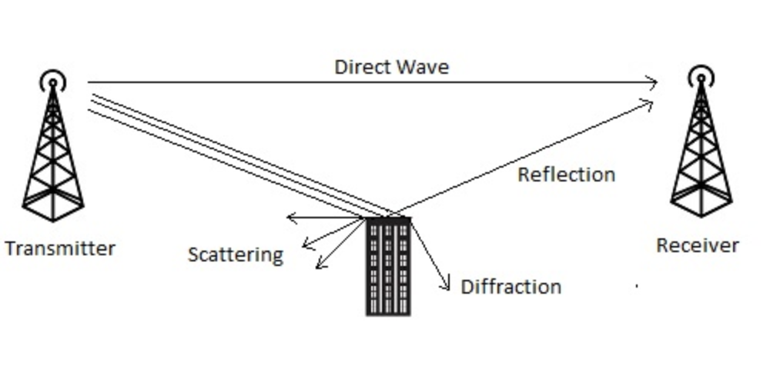
Multipath Transmission
Multipath fading --- Received signal made up from attenuated, reflected, transmitted and diffracted versions of original signal
Multipath fading is divided into slow and fast fading
When we have a direct wave from the transmitter to the receiver, then we have a Line of Sight (LoS) link
LoS
Multipath propagation can be described by the physics of three basic propagation mechanisms:
Reflection
Diffraction
Scattering
Non-LoS

Slide 16
Reflection
It occurs when an electromagnetic wave impinges upon an object that has large dimensions compared to the wavelength of the propagating wave (from surface of earth, buildings, walls)

Slide 17
Diffraction
It occurs when the path between Tx and Rx is obstructed by a surface with sharp irregularities (edges)

Slide 18
Scattering
It occurs when the medium through which the wave travels consists of objects with dimensions that are small compared to the wavelength, and where the number of obstacles per unit volume is large (produced by foliage, street signs, lamp posts)

Slide 19
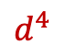

Slow Fading – Shadowing (1)
Slow variations in rx’d signal power as user moves, caused by attenuation by trees/buildings/etc.
In an urban environment, the average signal strength is often assumed to follow an inverse fourth law, instead of the inverse square normally seen in free space propagation
$$d^{2}$$
urban
$d^{4}$

Slide 20
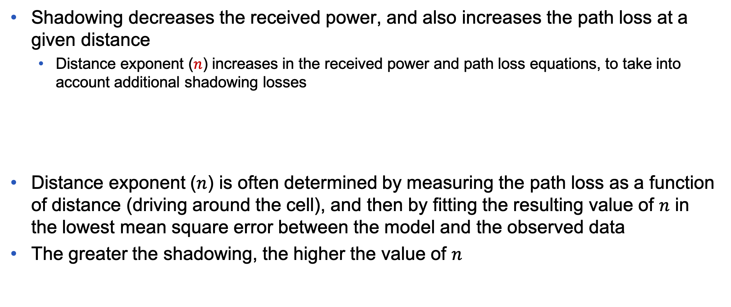
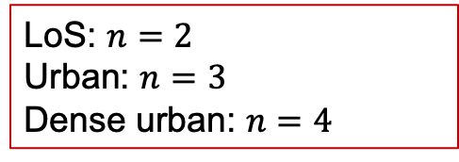
Slow Fading – Shadowing (2)
Shadowing decreases the received power, and also increases the path loss at a given distance
Distance exponent ($n$) increases in the received power and path loss equations, to take into account additional shadowing losses
Distance exponent ($n$) is often determined by measuring the path loss as a function of distance (driving around the cell), and then by fitting the resulting value of $n$ in the lowest mean square error between the model and the observed data
The greater the shadowing, the higher the value of $n$
LoS: $n=2$
Urban: $n=3$
Dense urban: $n=4$

Slide 21
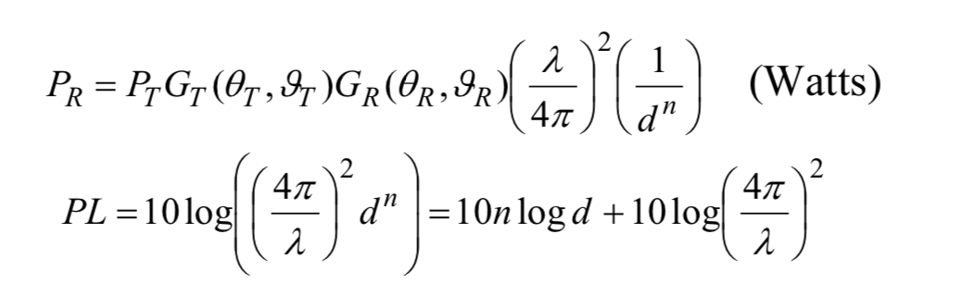
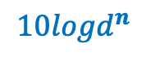


Slow Fading – Shadowing (3)
LoS: $n=2$
Urban: $n=3$
Dense urban: $n=4$
Rx’d power (distance dependent exponent $n$):
Path Loss:
$${10logd}^{n}$$

Slide 22
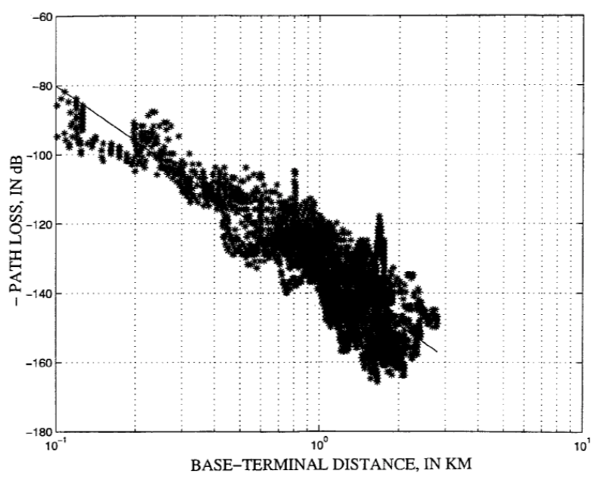
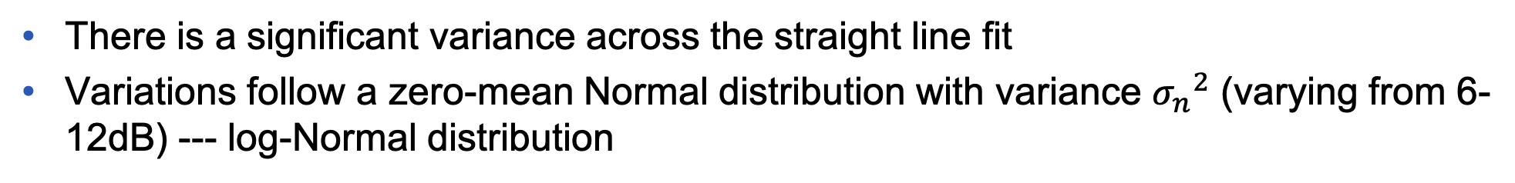
Shadowing
There is a significant variance across the straight line fit
Variations follow a zero-mean Normal distribution with variance ${σ_{n}}^{2}$ (varying from 6-12dB) --- log-Normal distribution
Shadowing can severely affect the received power, however its rate of change is generally low
(<2 times per second)
Slow variations of the channel
Big spread-variations in environment

Slide 23
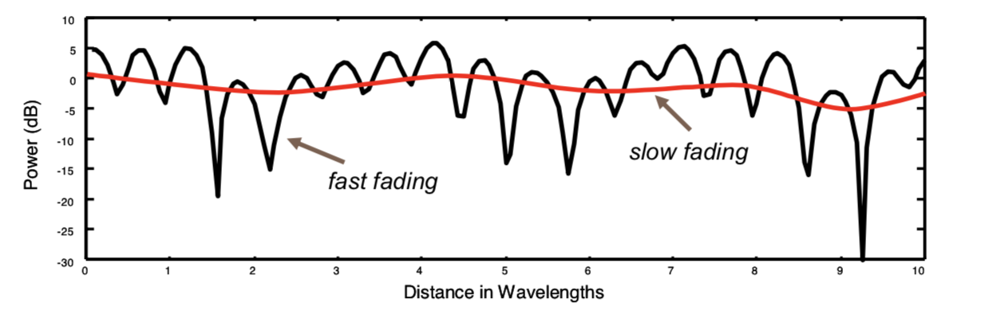
Fast Fading
Amplitude and phase change significantly as user moves
This can be attributed to the phasor addition of multipath signals
Notes:
Frequency is rate of change of phase

Slide 24
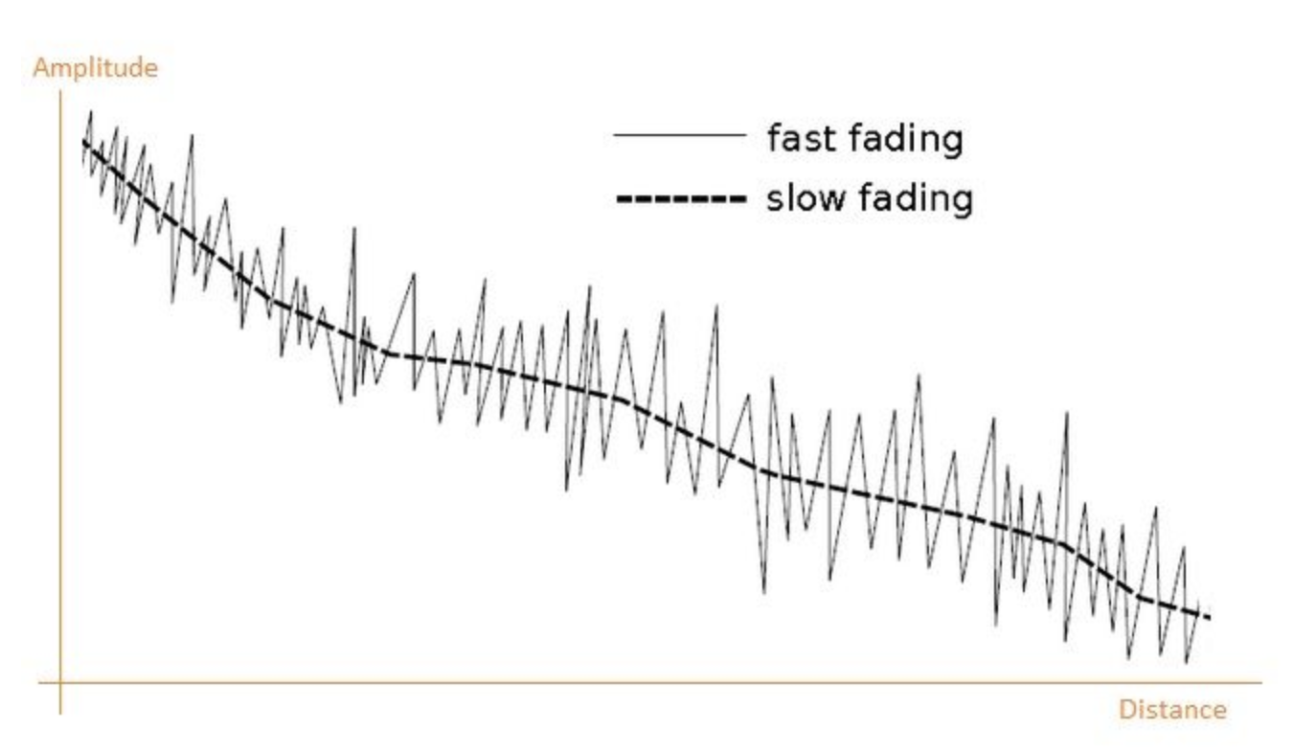
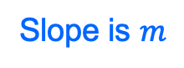

Fast and Slow Fading
$$y=mx+c$$
c
Slope is $m$
Path Loss
Notes:
Frequency is rate of change of phase

